Slide 1

CSN Patient Navigator Data foundation
Presentation by Team 8
1
Notes:
Confirmed script and slide

Slide 2
Agenda
1
Background & Project Context
2
Building the Database
3
Analysing the Database
4
How the Database can be used
2
Notes:
Confirmed just need to update script

Slide 3
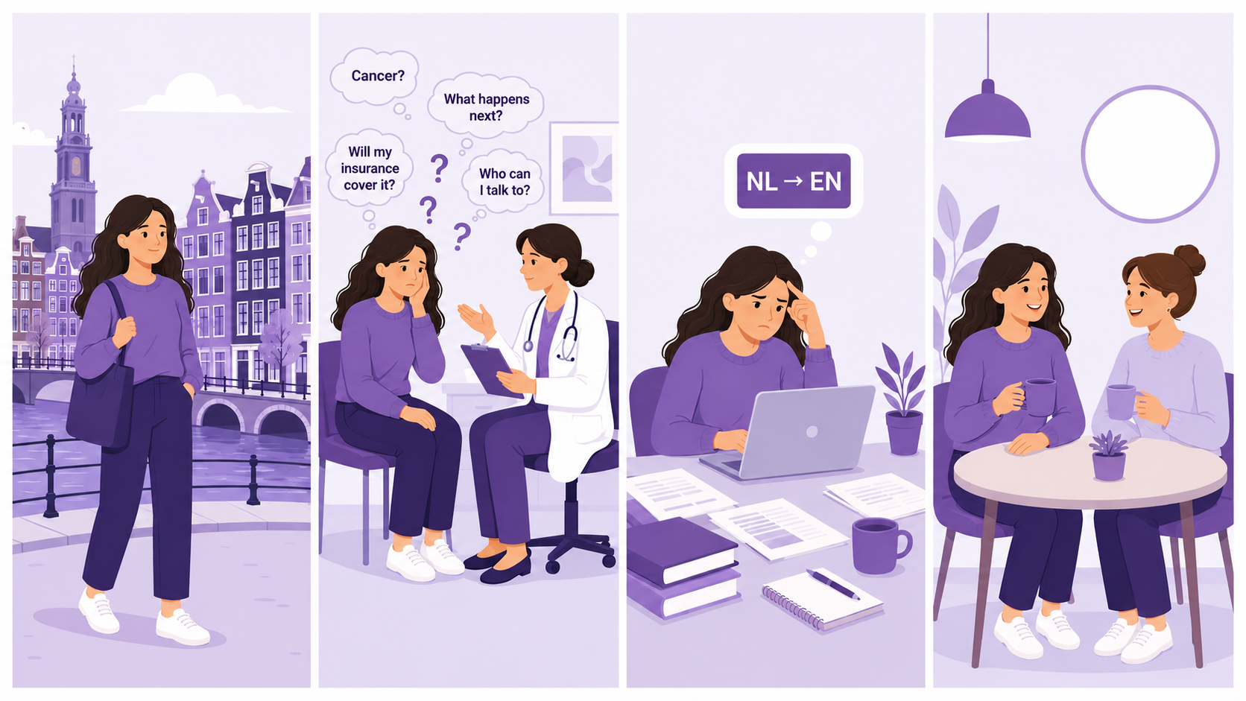

Background
10,000 EN-speaking internationals living in the NL diagnosed with cancer each year
Supports 130+ internationals navigating cancer in the NL
3
Notes:
Confirmed script and slide

Slide 4


Project Context
Project Aim:
Improve access to trusted cancer information for international patients navigating the Dutch healthcare system.
Project Objective:
Collect, translate, and organise trusted information into a consistent, English-language dataset, capable of supporting a Patient Navigator tool.
4
Notes:
Confirmed script and slide

Slide 5
Let's take you on the journey!
From building the database, to analysing it, to putting it to use
1
2
3
Building the Database
Analysing the Database
Using the Database
Scraping -> translating (deepl) -> classifying trusted Dutch sources
into one structured, English-language dataset.
Turning 144 pages into key insight — coverage, gaps, and overlaps across fields visualised via Tableau Dashboard.
Experimental wireframe displaying how the database can be used to shape a Patient Navigator that guides people with confidence.
5

Slide 6
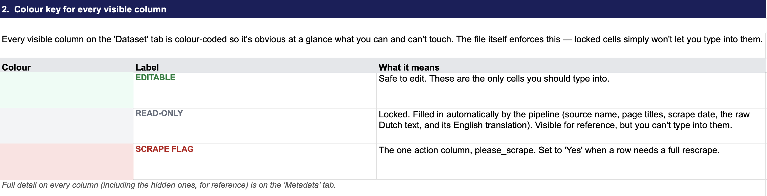
One Spreadsheet Runs the Whole Loop
Excel is the single tool CSN will uses to add, update, and refine content — no code experience required.
1 ADD & FLAG
2 RUN PIPELINE
3 MANUAL REVIEW
CSN_DATASHEET.xlsx
INSTRUCTIONS
EDITABLE
READ-ONLY
SCRAPE FLAG
6

Slide 7
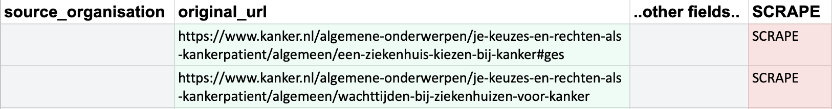
Step 1 — Add the URLs, Flag for Scrape
New source pages are added as rows and marked SCRAPE — everything else is left to the pipeline.
1 ADD & FLAG
2 RUN PIPELINE
3 MANUAL REVIEW
CSN_DATASHEET.xlsx
DATASHEET
a) TWO new rows/pages added
b) Flag set to SCRAPE
7

Slide 8
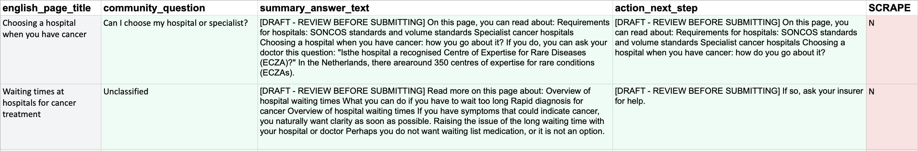
Step 2 — The Pipeline Fills In the Defaults
One script run scrapes, translates and classifies every flagged row automatically.
1 ADD & FLAG
2 RUN PIPELINE
3 MANUAL REVIEW
CSN_DATASHEET.xlsx
DATASHEET
a) Unclassified question needing manual review
b) DRAFT(s) needing manual finalisation
8

Slide 9
Step 2b - What the Code Does
1 Read & Scrape
Reads each flagged URL and scrapes the live page
Stored to the database: Scrape Date and Source Organisation
2 Translate
Detects Dutch text and translates it into English
Stored to the database: Original Dutch text and English translation
3 Tag
Scans each entry against reference libraries of Topic, Stakeholder and Community Question
Assigns and stores the matching tags automatically
4 Draft
Generates a draft summary and a draft next action
Clearly labelled as DRAFT for manual review — never published automatically
5 Write Back
Rewrites the formatted Excel sheet (CSN_DATASHEET.xlsx)
Mirrors the same update into the SQL database
9

Slide 10
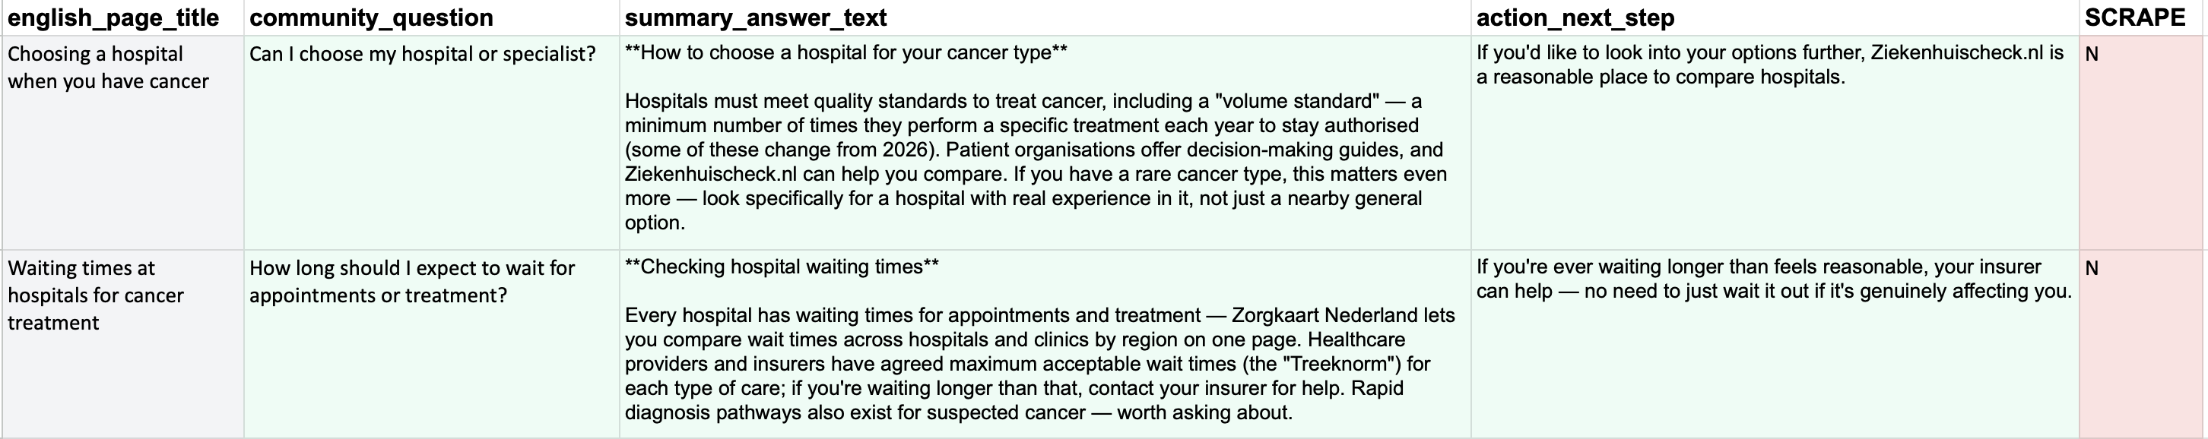
Step 3 — The Final Human Touch
Manual review corrects classifications and finalises the summary and next-step text.
1 ADD & FLAG
2 RUN PIPELINE
3 MANUAL REVIEW
CSN_DATASHEET.xlsx
DATASHEET
a) Previously “unclassified” question now classified
b) DRAFT warning cleared
summaries + next steps finalised
10

Slide 11
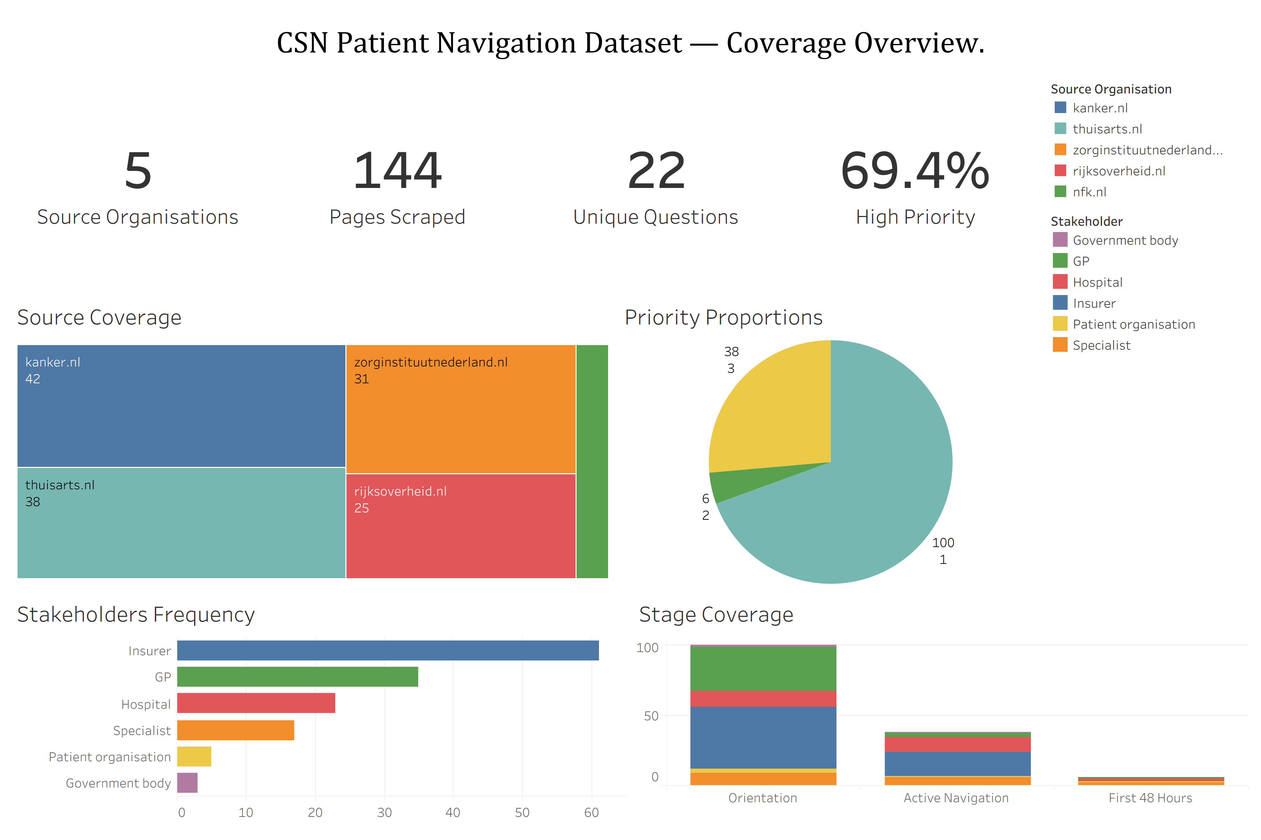
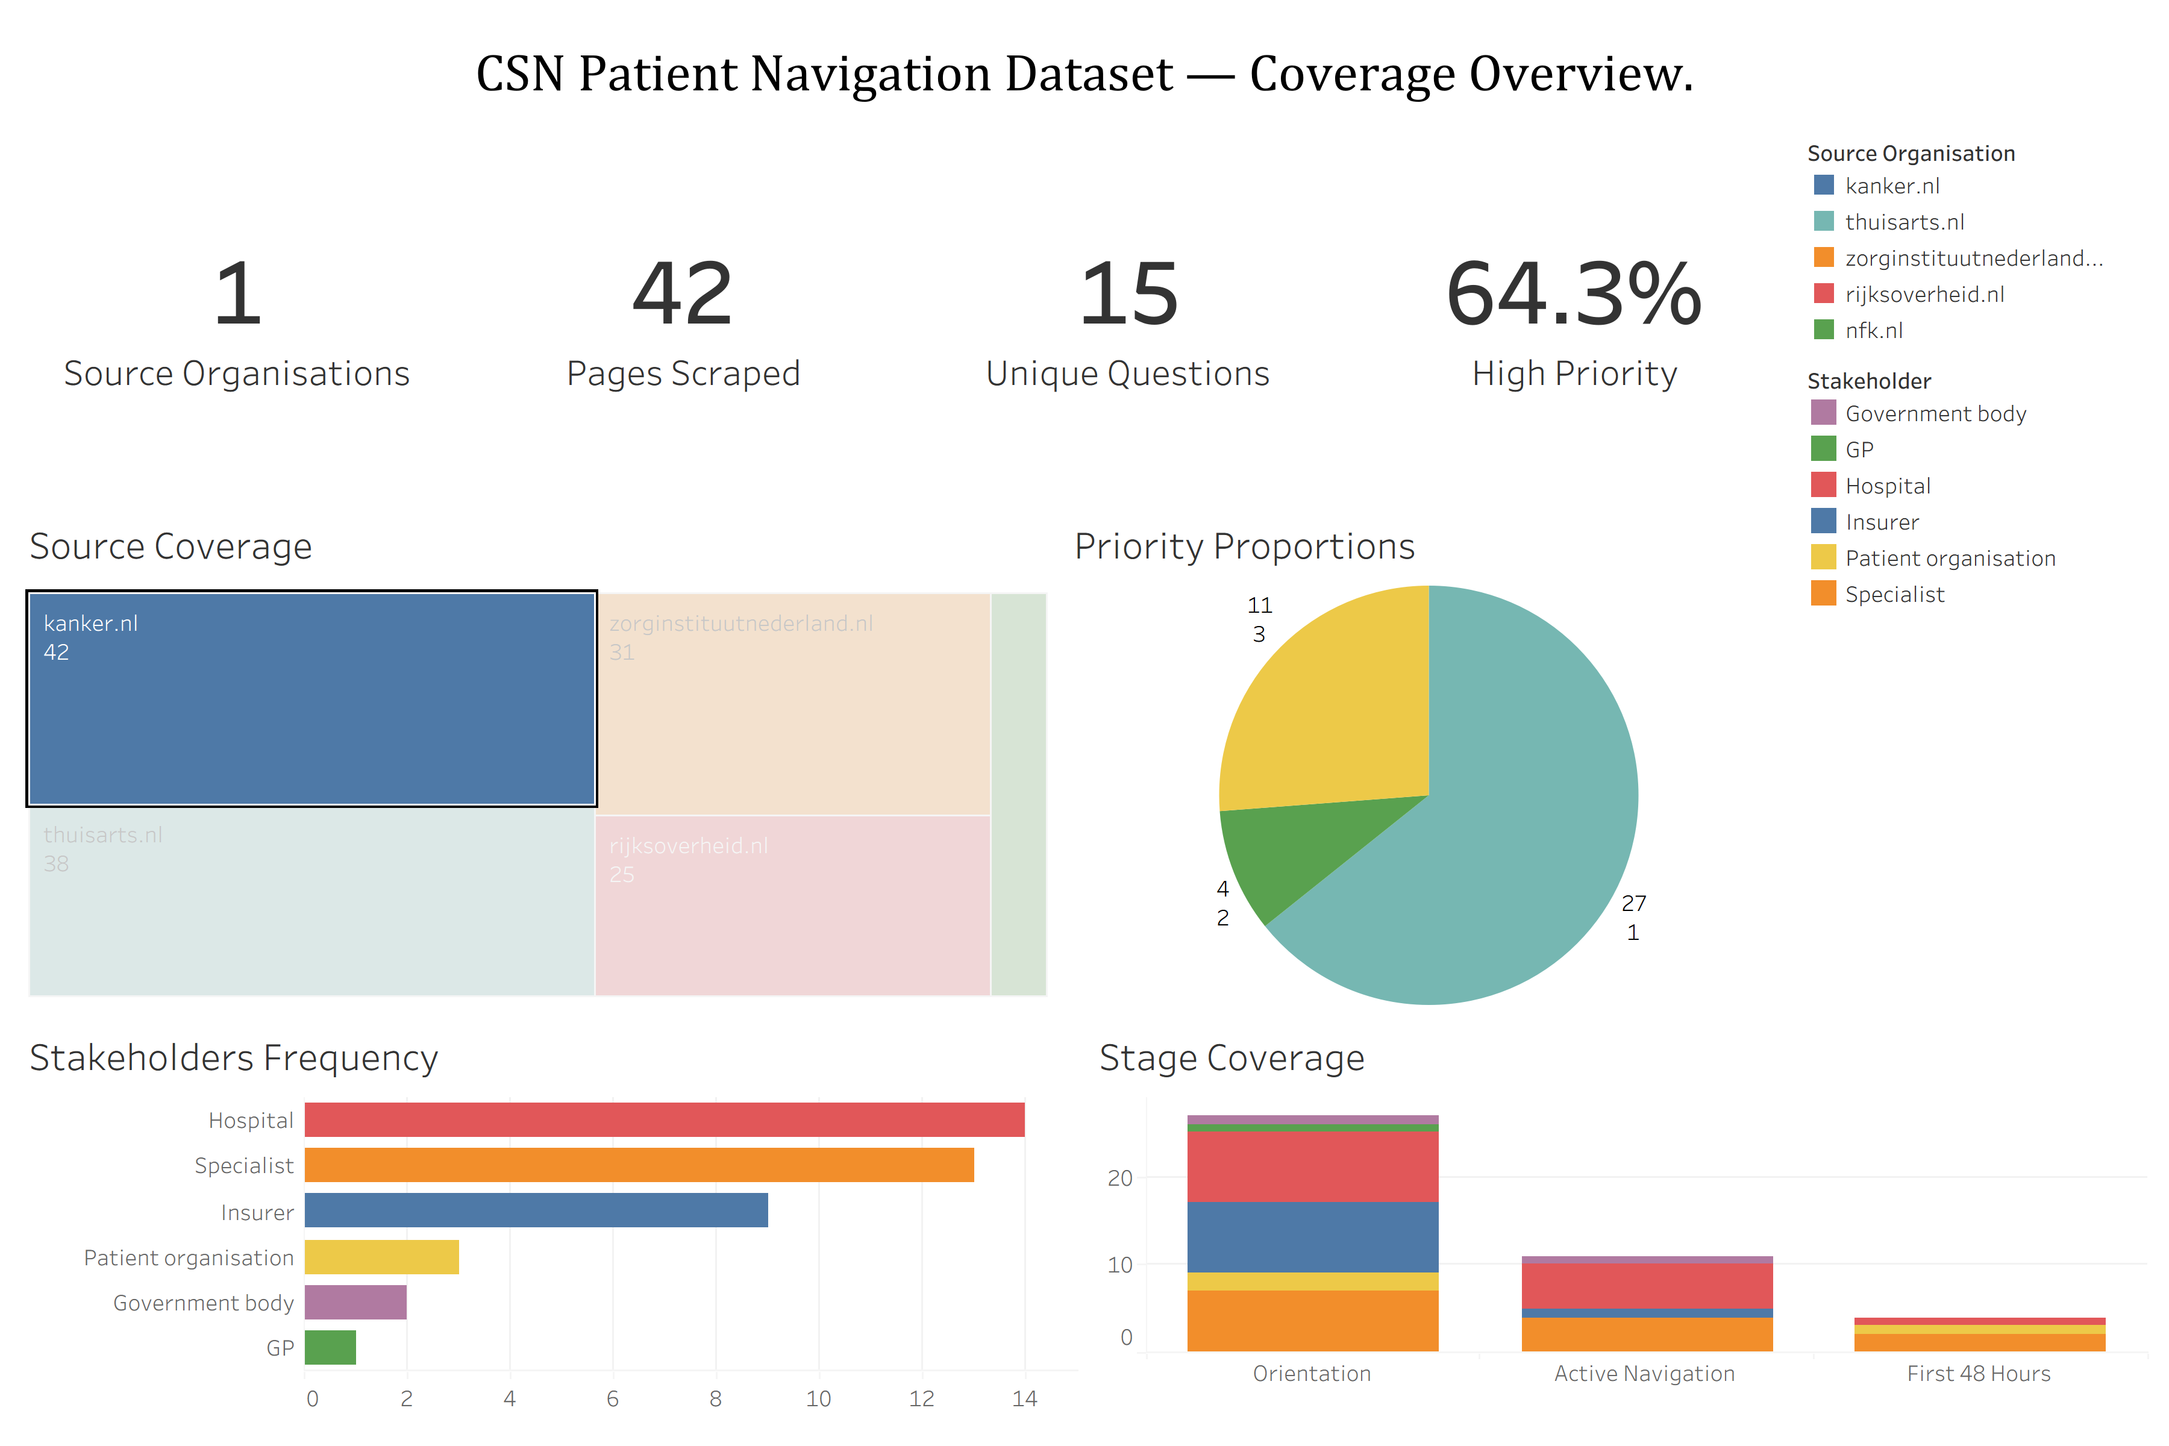
One Dashboard, Every Angle
Your dataset as a live, filterable Tableau dashboard
4 live KPI cards
Filterable by any chart or field
E.g. Clicking source reveals its entire footprint
All Sources — Unfiltered
Filtered on Source: kanker.nl
CSN_DATASHEET_DASHBOARD.twb
DASHBOARD 1
CSN_DATASHEET_DASHBOARD.twb
DASHBOARD 1 · Filtered
11
Notes:
Confirmed script and slide

Slide 12
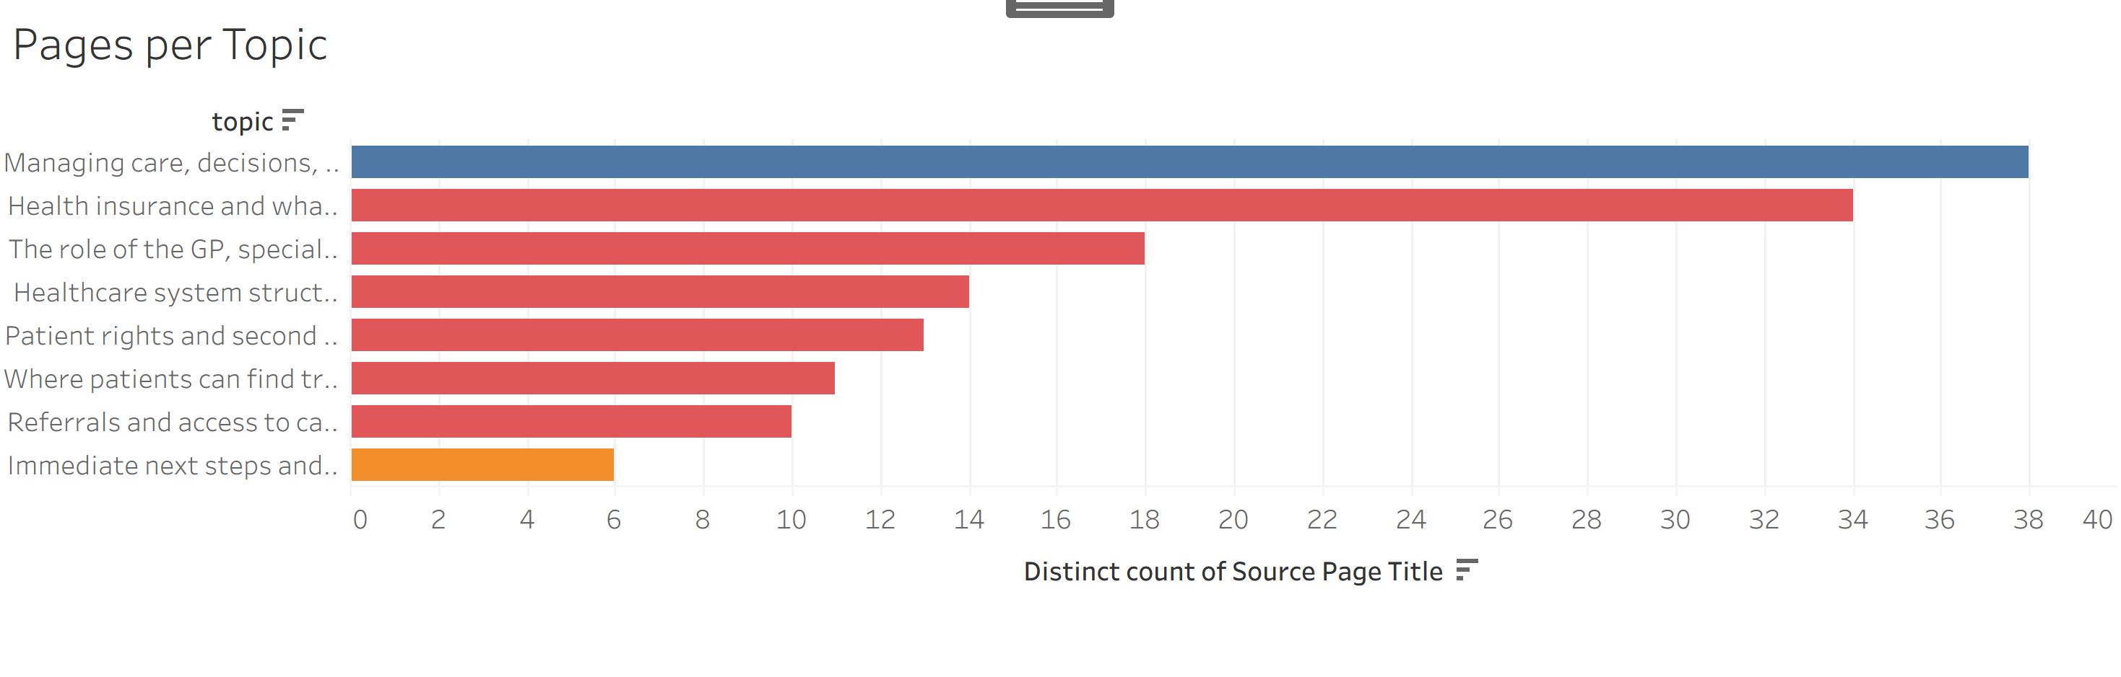
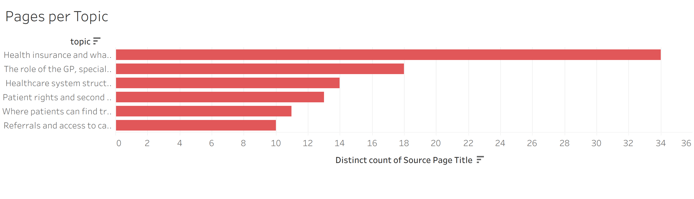
Where Should Patients Start?
BRIEF QUESTION: What do international patients need to understand before navigating the system confidently?
CSN_DATASHEET_DASHBOARD.twb
DASHBOARD 2
ORIENTATION-STAGE:
100 of 144 pages in the dataset
Focus: Insurance + System structure
Health insurance and what may be covered
34 of 100 Orientation pages— the single largest topic
Filtered by Orientation-stage
1
CSN_DATASHEET_DASHBOARD.twb
DASHBOARD 2
The role of the GP, specialist & hospital
18 of 100 pages — the second-largest orientation topic
Pages per Orientation Topic(s)
2
3
Healthcare system structure
14 of 100 pages — rounding out the top three
Stage: (red: Orientation // orange: First 48h // blue: Active Navigation)
12

Slide 13
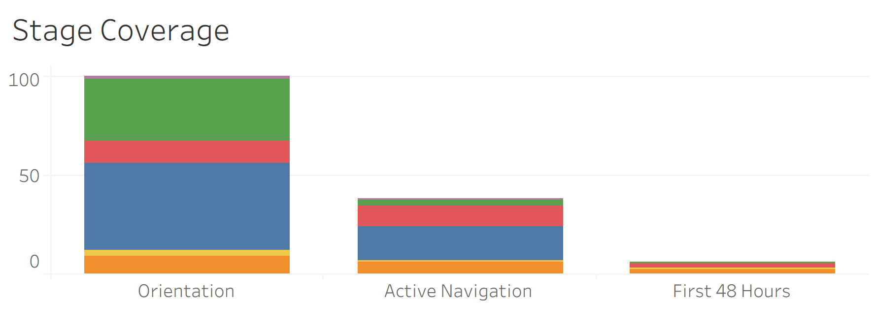
Stage/Priority coverage
BRIEF QUESTION: Extending beyond the core scope, how do information needs differ across First 48 Hours and Active Navigation?
CSN_DATASHEET_DASHBOARD.twb
DASHBOARD 1
Orientation dominates
100 of 144 pages → 69% of database is Level 1 (Top) priority
First 48 Hours
6 of 144 pages → 4% of database is Level 2 priority
Active Navigation
38 of 144 pages → 26% of database is Level 3 priority
⚠️ Gap: First 48 Hours content is slim across trusted sources
Not a flaw in our process = Reflects where Dutch sources concentrate their content
Recommendation:
Expand into peer-support and community-authored content (e.g. CSN's own material) to provide information that would meaningfully support this stage.
13

Slide 14
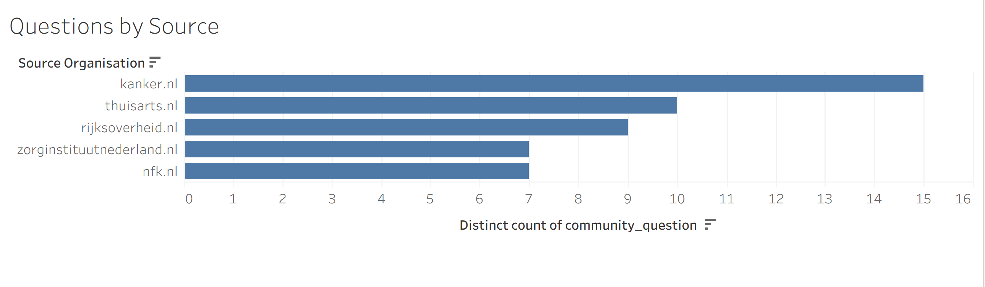
Best Sources by Question Coverage
BRIEF QUESTION: Which sources best answer CSN's community questions about orientation, healthcare roles, rights, insurance, and referrals?
All 144 pages mapped against CSN’s 17 community questions + 5 additional Qs added under the original headers
Kanker.nl answers 15 of the 22 questions – Most of any source
Question Coverage
Thuisarts.nl (10) and Rijksoverheid.nl (9) are distant seconds
What does my health insurance actually cover, and what will it cost me?
37 pages
Zorginstituutnederland.nl (7) and NFK.nl (7) are tied lowest
What should I expect when I visit my GP, and how does registering work?
19 pages
What additional services can I access?
14 pages
CSN_DATASHEET_DASHBOARD.twb
DASHBOARD 1
What are my general rights and responsibilities as a patient?
12 pages
Questions answered by source
How do I get referred to psych care, physiotherapy or fertility support?
9 pages
How do I find reliable health information or a trustworthy provider?
9 pages
Top 6 of 22 tracked questions, by number of source pages.
14

Slide 15
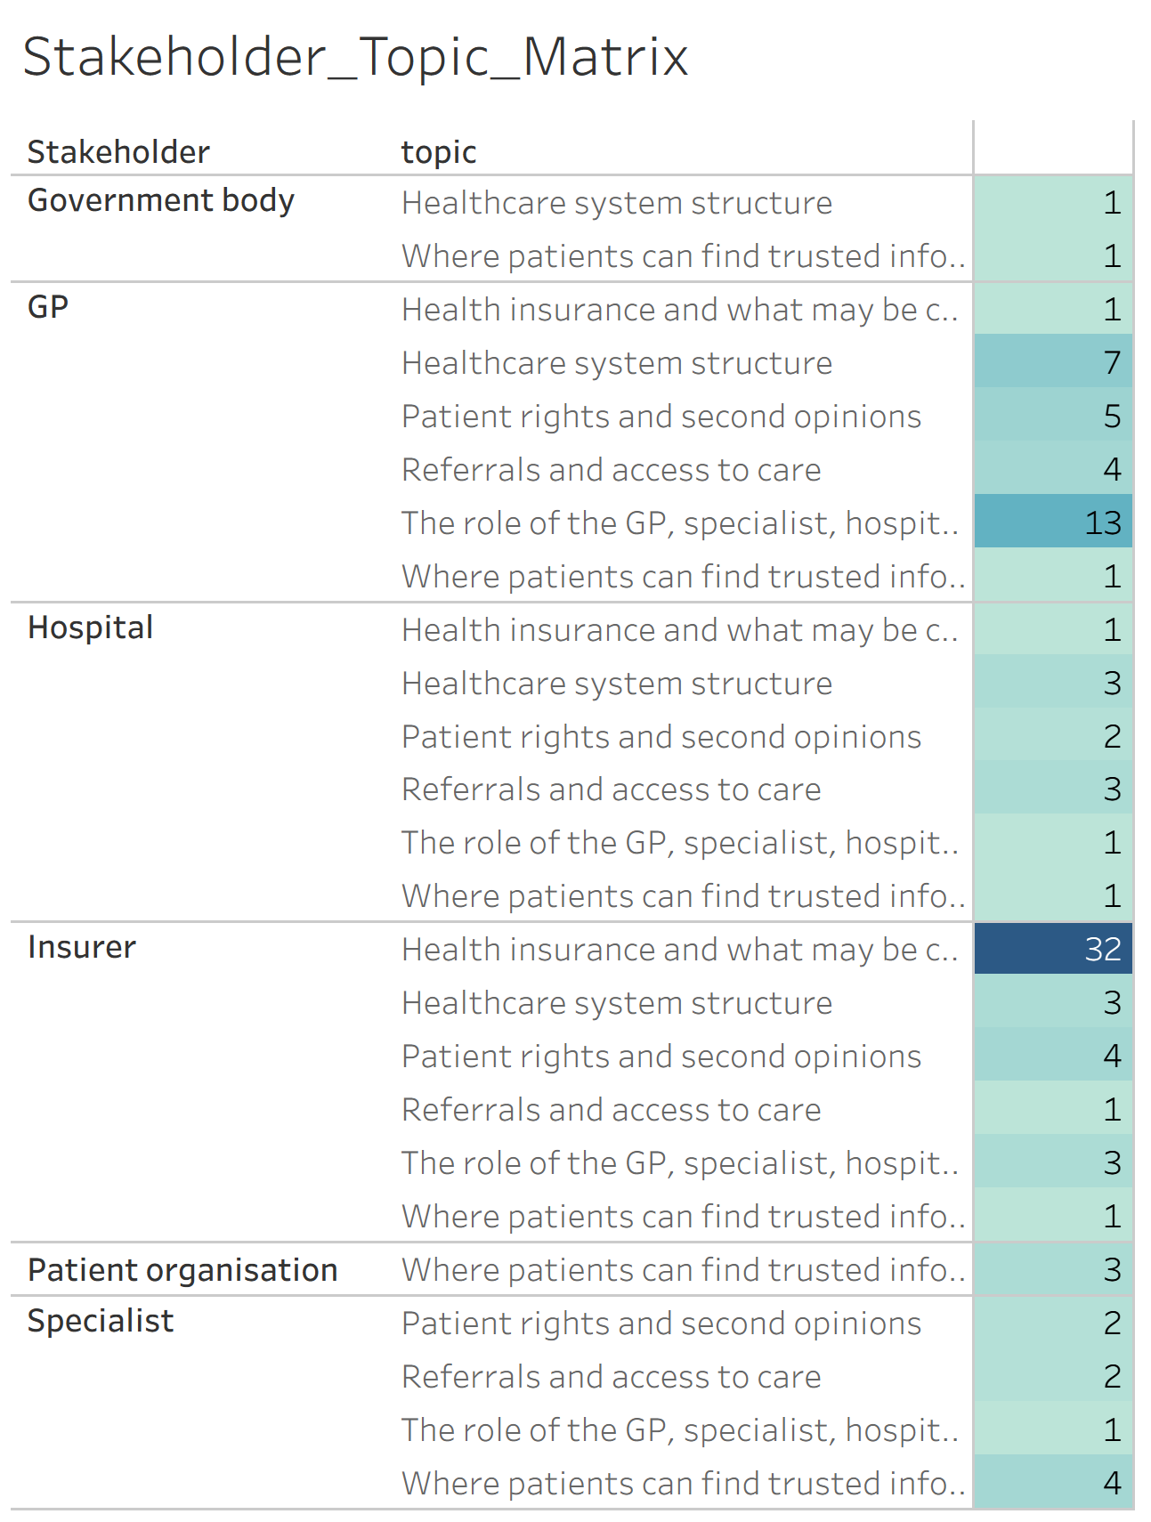
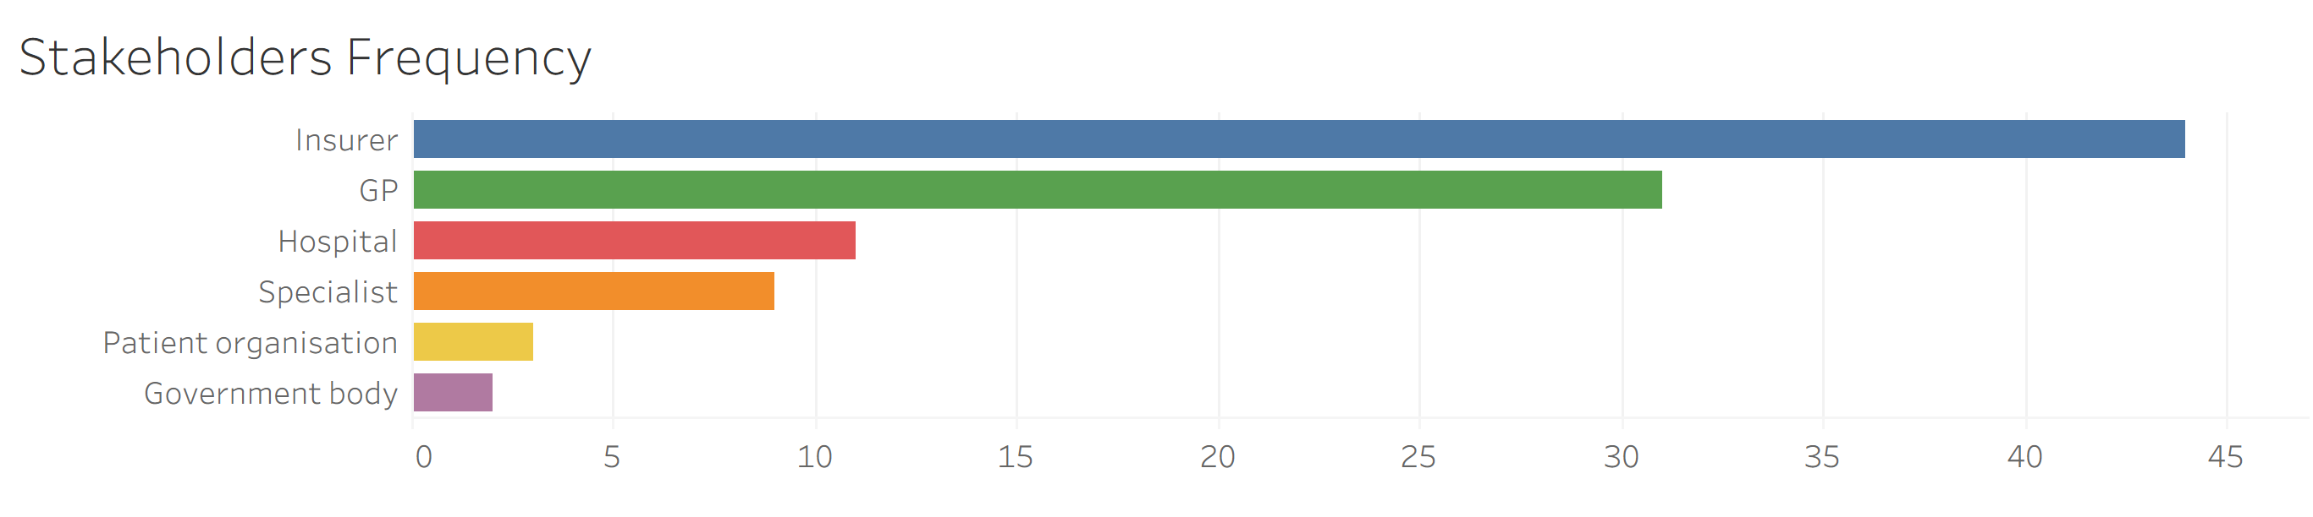
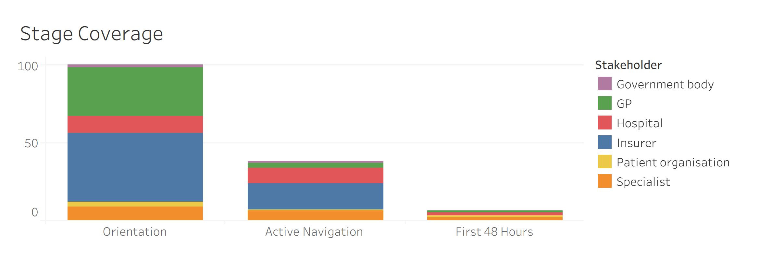
Stakeholder Coverage by Stage
BRIEF QUESTION: “Which stakeholders appear most often in the orientation stage?”
Insurer 44 pages
- Most of any stakeholder
CSN_DATASHEET_DASHBOARD.twb
MATRIX
Coverage skewed toward:
Procedural stakeholders
“who to deal with”
GP (31), Hospital (11) and Specialist (9)
- Dutch referral gatekeeper model
VS
Advocacy stakeholders
“who advocates/governs”
Patient Org. (3) & Gov. body (2)
- Notably thin
CSN_DATASHEET_DASHBOARD.twb
DASHBOARD 1
Orientation Stakeholder Coverage
15

Slide 16
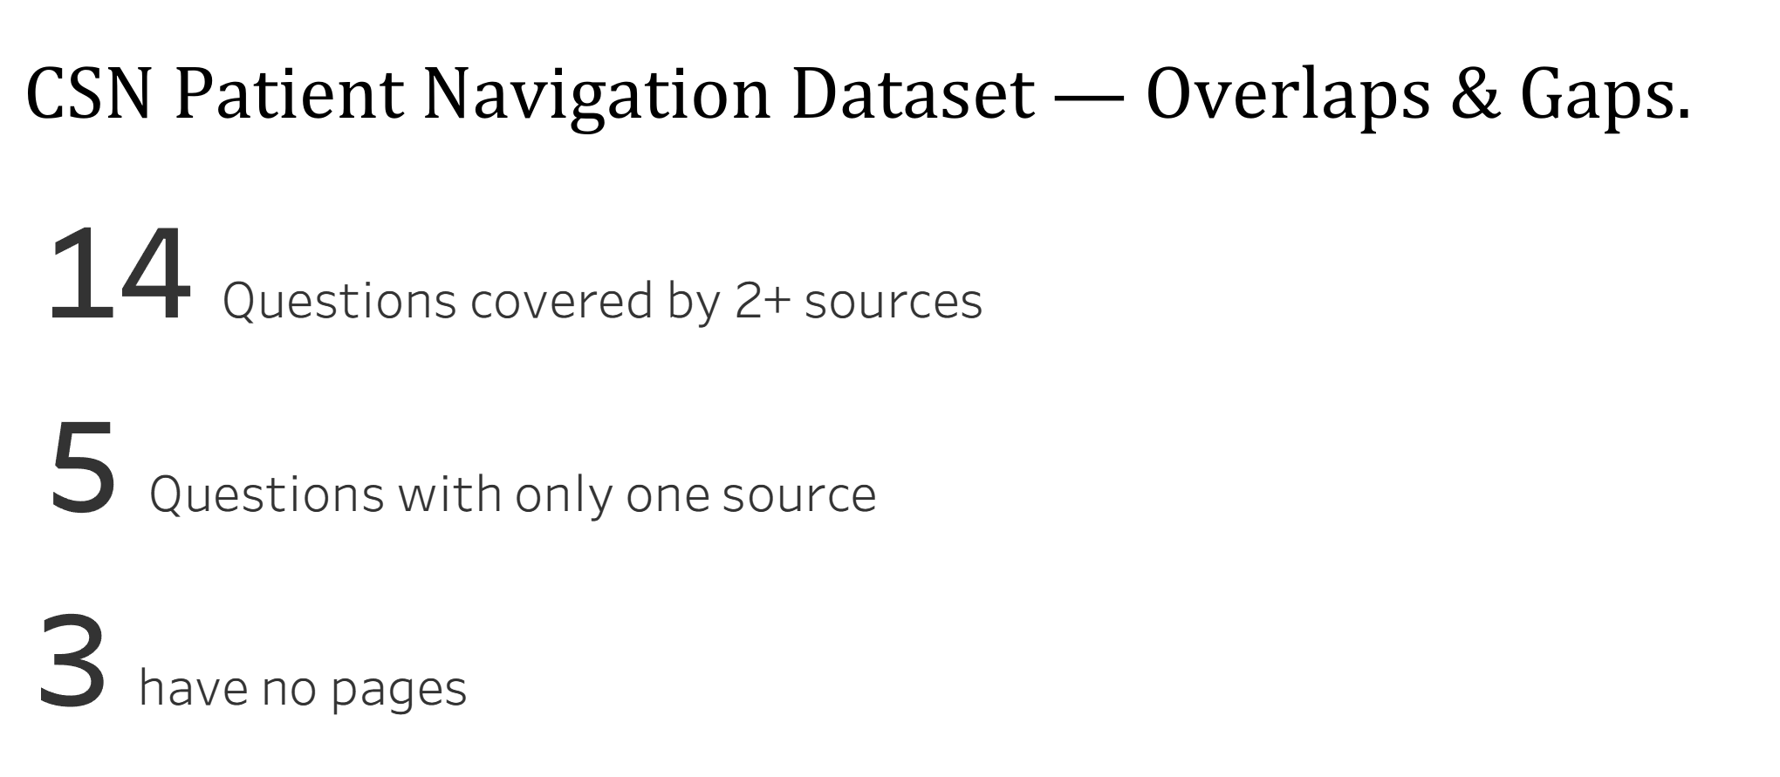
Every Gap and Overlap Made Visible
BRIEF QUESTION: Where are there gaps, overlaps or inconsistencies across the selected sources?
14
Answered by multiple pages
5
Answered by one page
3
No pages
22
Questions tracked
4
Pages don’t answer Q
What if I don't understand medical terminology?
CSN_DATASHEET_DASHBOARD.twb
DASHBOARD 3
No Source Page
3
Only One Source Page
5
What can I do if the process feels too slow?
Will a second opinion be covered by insurance?
Is it normal to wait between steps?
Am I allowed to get a second opinion, including in another country?
How do I request a second opinion?
Can I change doctors?
Gaps: Trace to near-duplicate questions folded into a closer-matching sibling.
Overlaps: Genuine but not duplication: no two pages share the same summary or action text.
Are there English-speaking healthcare providers?
16
Notes:
Confirmed just need to confirm script (Tableau ss are already updated – could maybe add the page with no question allocated to the tableau dashboard overlaps and gaps summary + Add that 14 answered by multiple SOURCES eg. Kanker.nl and thuisarts.nl to dashboard.

Slide 17
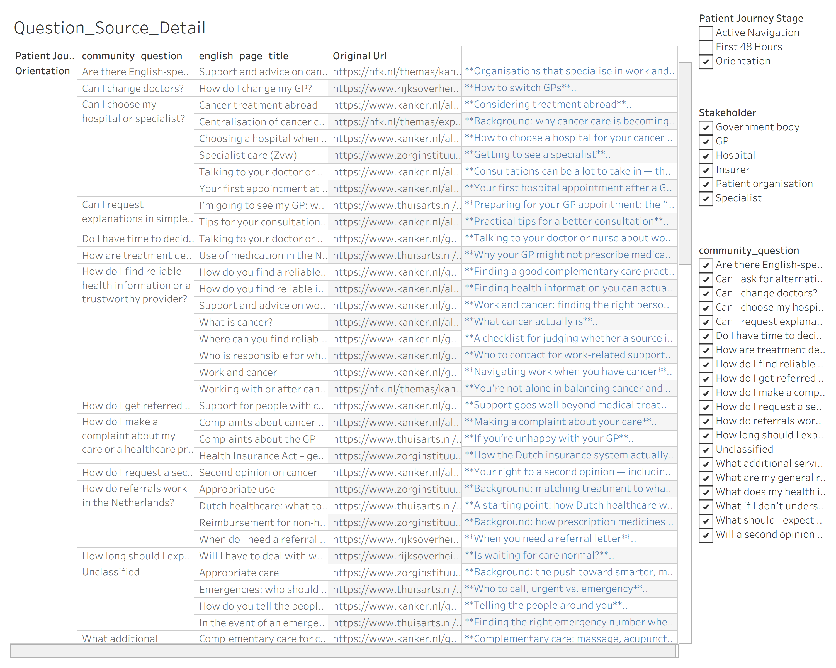
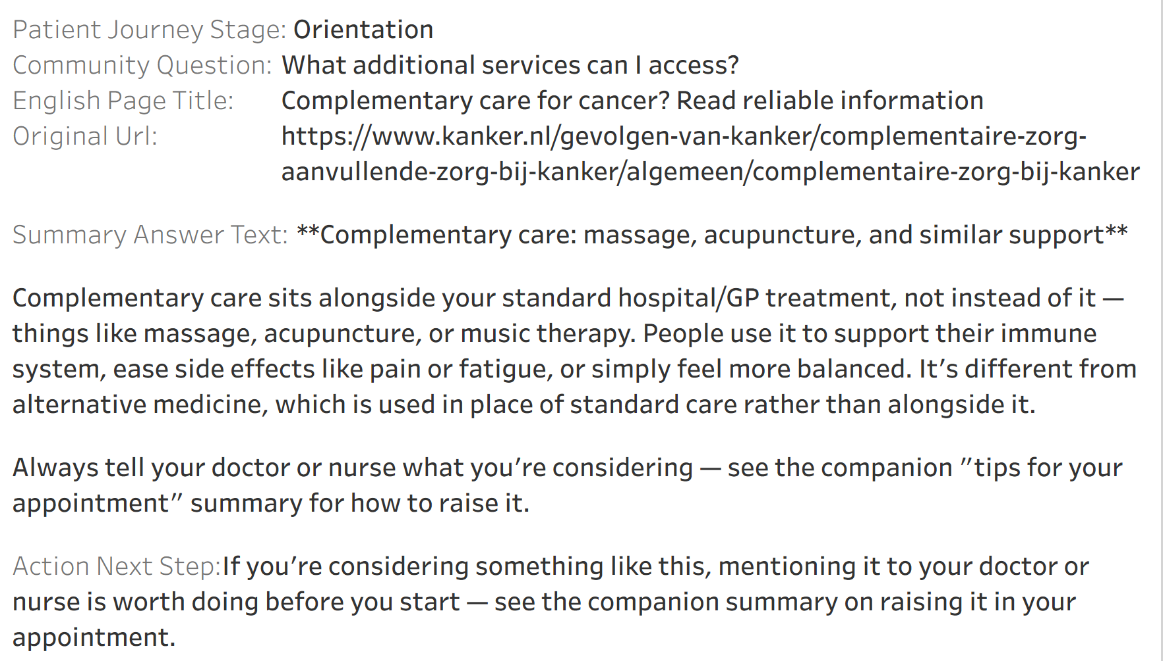
Tagging trail = Navigator trail
BRIEF QUESTION: “How should content be tagged so it can support a future Patient Navigator or chatbot?”
144 pages, fully cross-referenced
Filterable = Retrieve content by any field
(E.g. Source, Topic, stakeholder, stage)
Hover over rows to reveal full
source trail
CSN_DATASHEET.twb
DETAIL VIEW
CSN_DATASHEET.twb
HOVER BOX
17

Slide 18

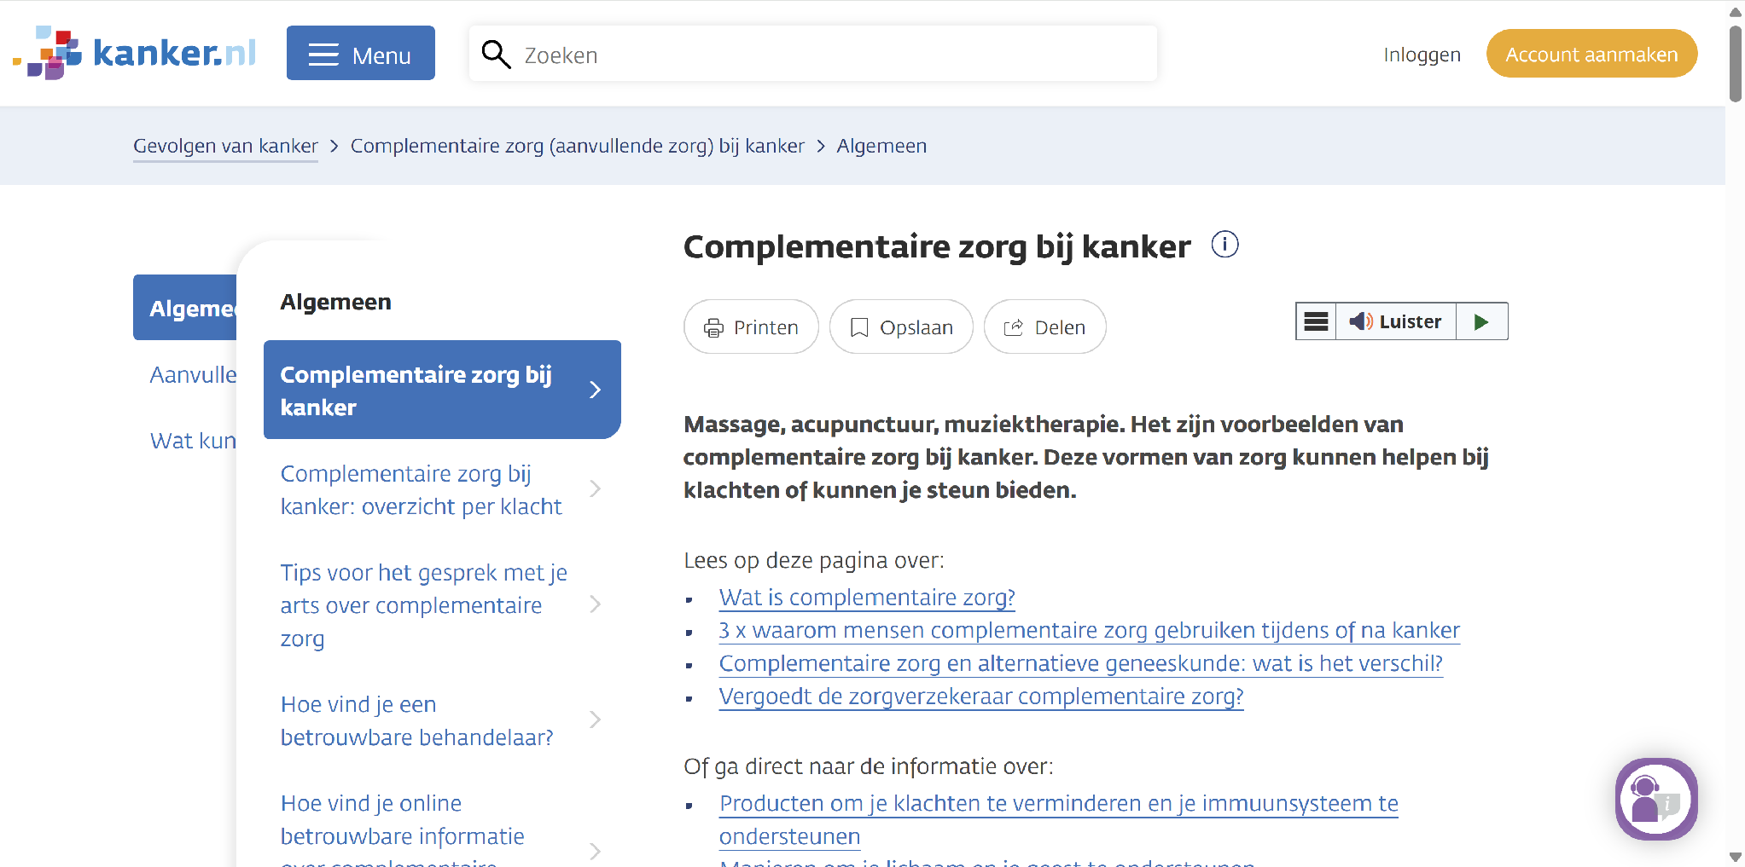
Tagging Every Link Traces Back
BRIEF QUESTION: “How can source links, provenance and update logic be preserved?”
Any answer is source verifiable
SCRAPE flag keeps trail current without disturbing what is already there
CSN_DATASHEET.twb
HOVER BOX
kanker.nl
18

Slide 19
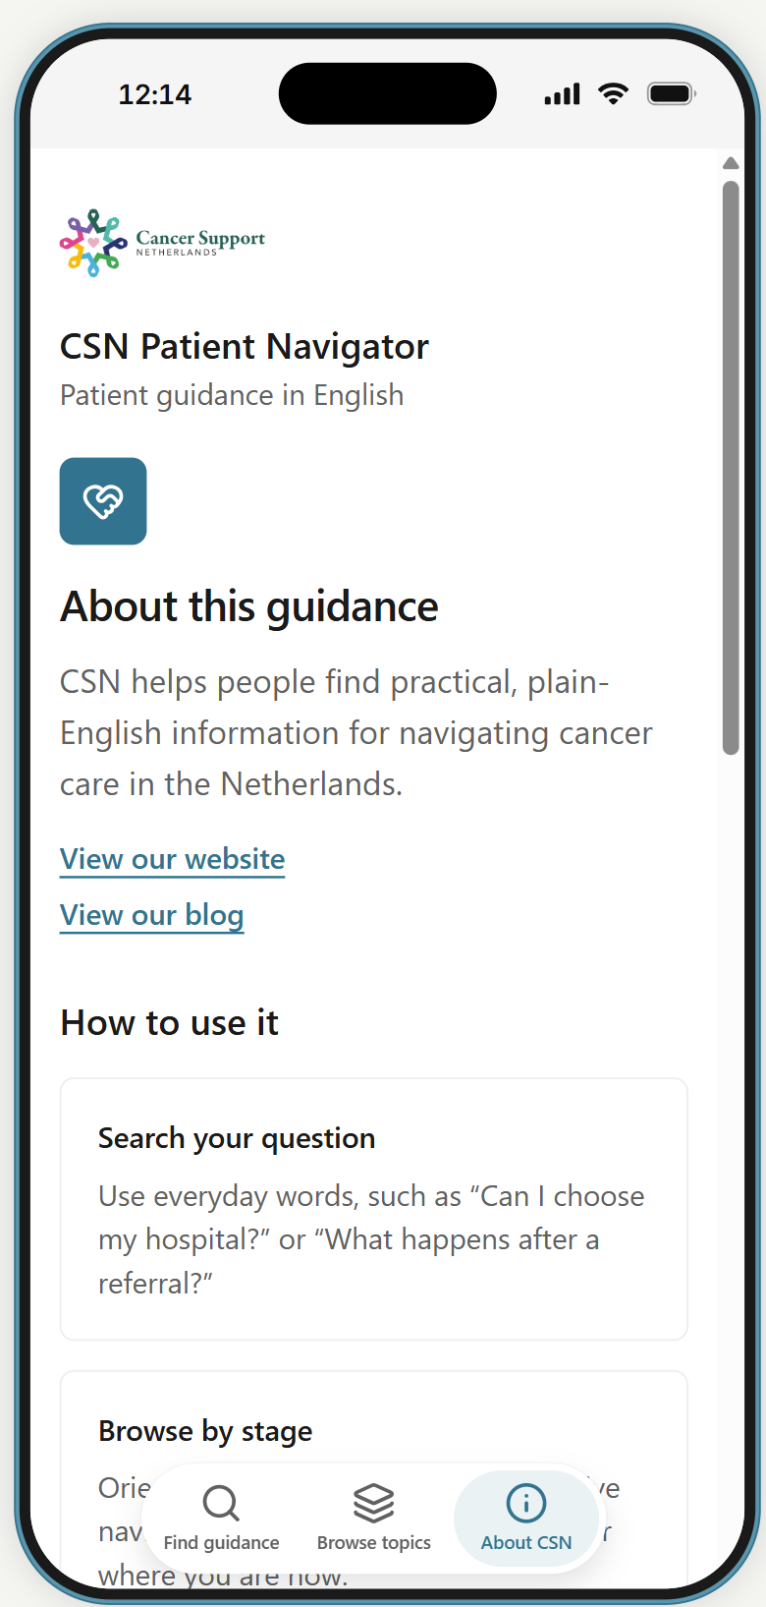
One Dataset, Every Doorway
FROM THE BRIEF: "Provide a usable starting point for a future Patient Navigator or chatbot."
The same structured data could power a website, a chatbot, or a mobile app.
Same question, same source
The exact matches from our database, now shown directly to a patient.
Ask, or browse by tab
Free-text search, or jump straight to a stage or source — same dataset either way.
One dataset, many doors
This structured data could equally power a website or chatbot — the app is just one option.
19

Slide 20
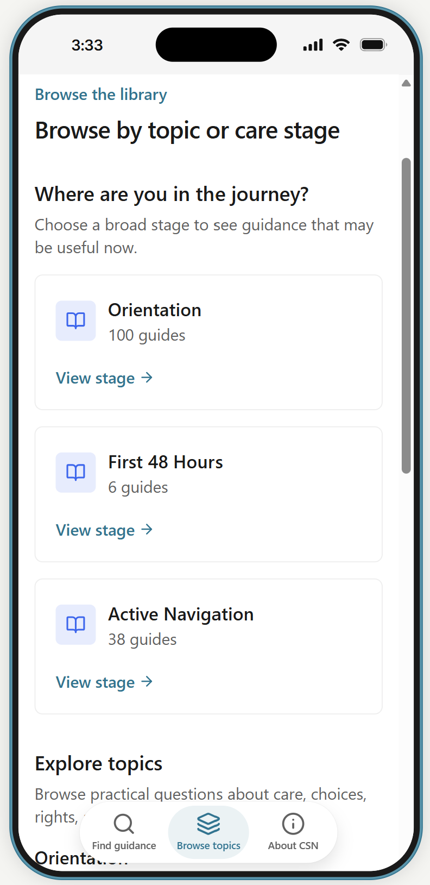
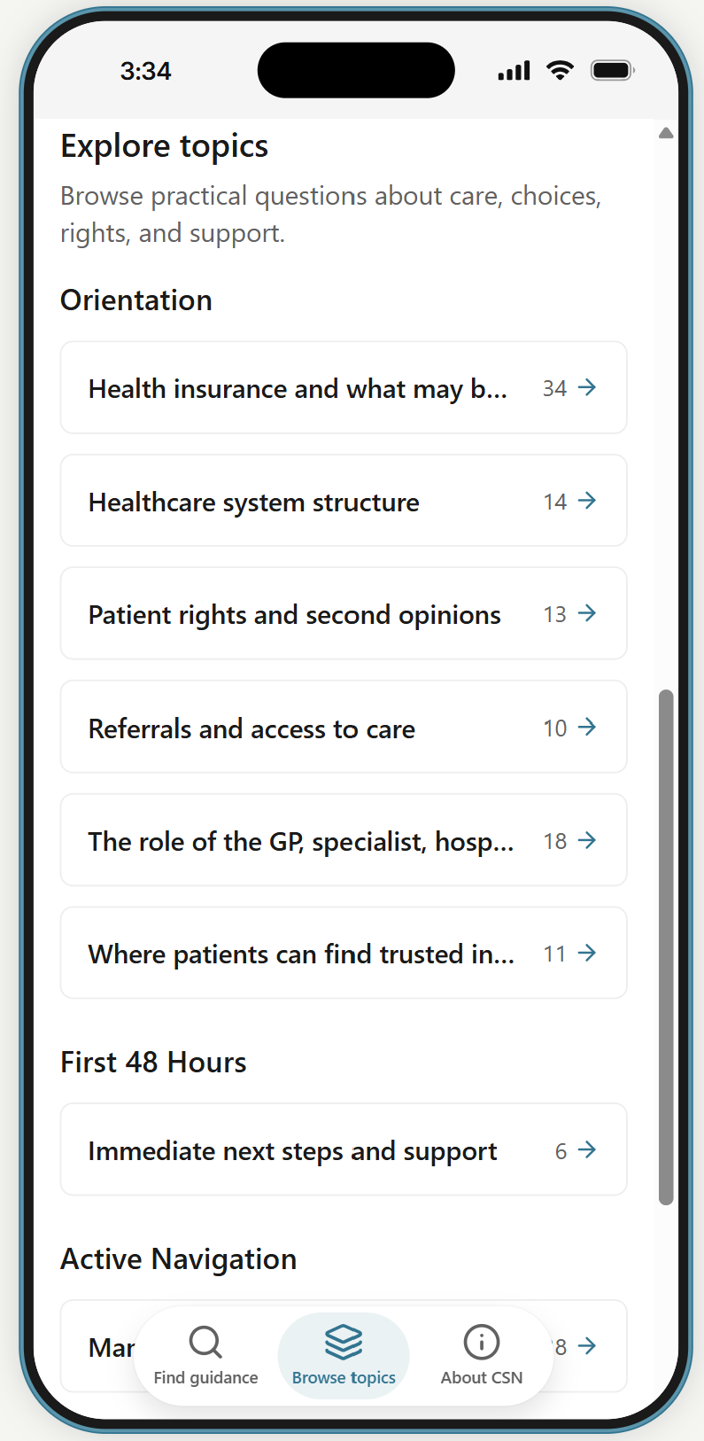
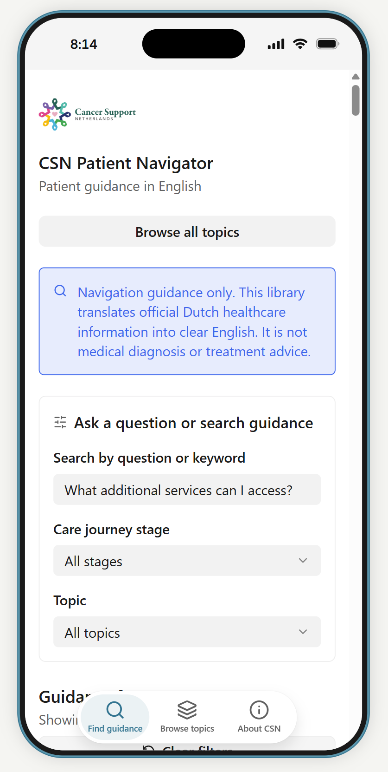
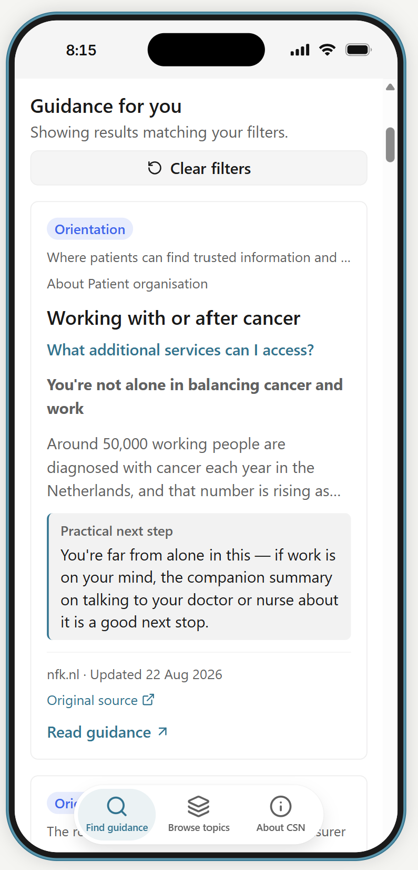
One Dataset, An Example Doorway
FROM THE BRIEF: "Provide a usable starting point for a future Patient Navigator or chatbot."
Example a mobile app wireframe:
Browse by stage
OR by topic
OR free-text search
Straight to the answer
Jump straight to Orientation, First 48 Hours, or Active Navigation.
Explore guides grouped by health insurance, rights, referrals and more.
A search bar finds guidance by question or keyword, any time.
Summary and next action up top; source link and full text below.
20

Slide 21
Thank you
For any questions you may have post-meeting, get in touch with the team via email: aniquekuiper@gmail.com
21

Slide 22
Additional Slides
Not part of presentation - but available resources if asked!
22

Slide 23
Costs
Every layer of the toolchain the project runs on — at zero cost to CSN.
TOOL
COST
1
Excel
No cost
Drives the project. Can be edited as a Google Sheet and downloaded as an Excel file if needed.
2
Python engine
No cost
Runs as a free program inside a Jupyter notebook.
3
DeepL (translation)
No cost
Coded to translate only when needed — a free api account covers 1.000,000 characters – over 150 URLs.
4
Tableau (visualisation)
No cost
CSN is a low-budget charity with ANBI status — qualifies for a free account via TechSoup Nederlands.

Slide 24
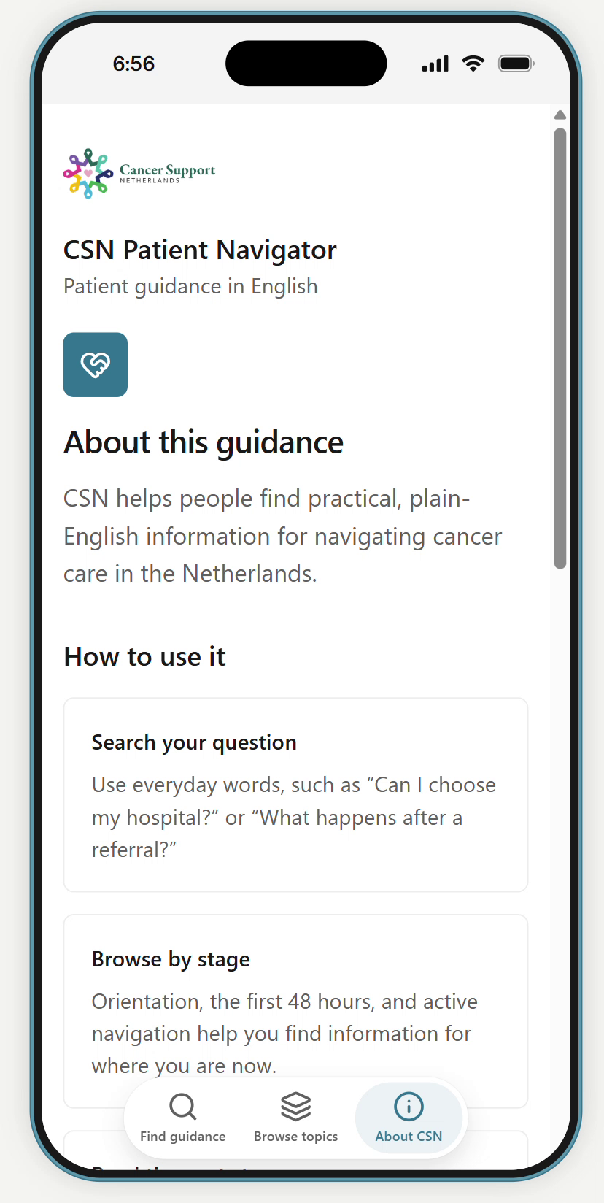
One Dataset, Every Doorway
The same structured data could power a website, a chatbot, or a mobile app.
FROM THE BRIEF: "Provide a usable starting point for a future Patient Navigator or chatbot."
Same question, same source
The exact match from Dashboard 4, now shown directly to a patient.
Ask, or browse by tab
Free-text search, or jump straight to a stage or source — same dataset either way.
One dataset, many doors
This structured data could equally power a website or chatbot — the app is just one option.
25

Slide 25
Old slides beyond here.
Can be deleted if we decide not to use them.

Slide 26
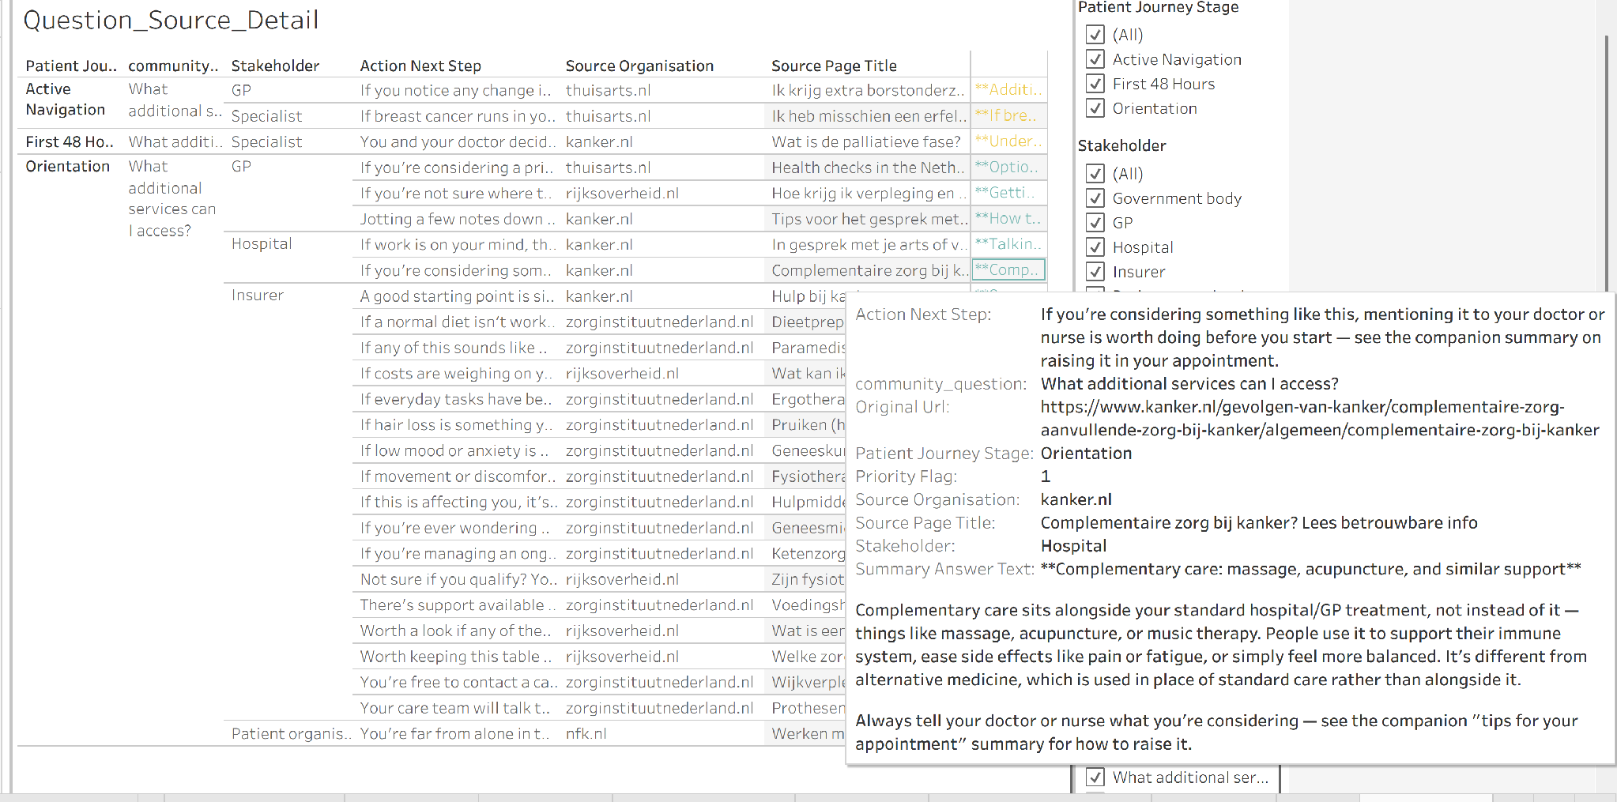
Drilling Into One Question
BRIEF QUESTION: “How should content be tagged so it can be retrieved by topic, stakeholder, action, and source?”
One question, filtered — its full source trail appears instantly.
CSN_DATASHEET.twb
DETAIL VIEW
Filtered to one community question
Hover any row for the full citation
18

Slide 27
Background
Who are CSN?
Current Challenges:
A cancer support community-led organisation
Health Information online is mainly in Dutch
Supports non-Dutch-speaking internationals living in the Netherlands who are navigating cancer
Health Information is spread across numerous websites
The Dutch system is already challenging to navigate & understand
Established in 2025 with approximately 130 members
3

Slide 28
Our Approach
Source selection:
Selected relevant pages from approved trusted source
Web scraping:
Collecting webpage content and titles with Python
Translation:
Dutch content translated into English using DeepL
Classification and tagging:
Embedding-based methods tagging by topic, community question & stakeholder
Manual review: corrects and finalises flagged entries
Structuring and storage:
Structured into database containing required fields
Stored in SQLite
Edits and updates through a simple Excel interface
Visualisation and analysis:
Key insights and navigator database visualised using Tableau
5

Slide 29
Classification and Quality Control
Automated classification provides a first pass, followed by human validation to ensure accuracy:
Automated Classification & Mapping
Topic, stakeholder, patient stage, priority flag classification
Community question mapping
Draft summary/answer & action texts
Human Validation & Quality Control
Review full translated content
Correct unclassified or inaccurate classifications
Finalise summary & action text
Gap & overlap identification
Corrections retained for future runs
Automation improves efficiency; Human review ensures the final dataset is accurate, consistent and reliable.
6

Slide 30
The Database:
Automated tagging provided a strong first pass (76% classified) 🡪 Manual human edit closed the remaining gap flagged for manual review (24%)
14 Fields
5 Source Orgs
144 Pages
81% core scope
- Original URL
- Source organisation
- Original Dutch text
- English translation
- Dutch page title
- English page title
- Scrape date
- Topic
- Patient journey stage
- Stakeholder
- Community Question
- Summary / answer text
- Action / next step
- Priority flag
- kanker.nl
- rijksoverheid.nl
- thuisarts.nl
- zorginstituutnederland.nl
- nfk.nl
Updating:
Add new URL
Mark “Yes scrape”
Run code
Re-open excel sheet
Manually classify any unclassified cells & finalise summary and action text
Rerun code
Excel sheet & Tableau dashboard updated
7
7

Slide 31
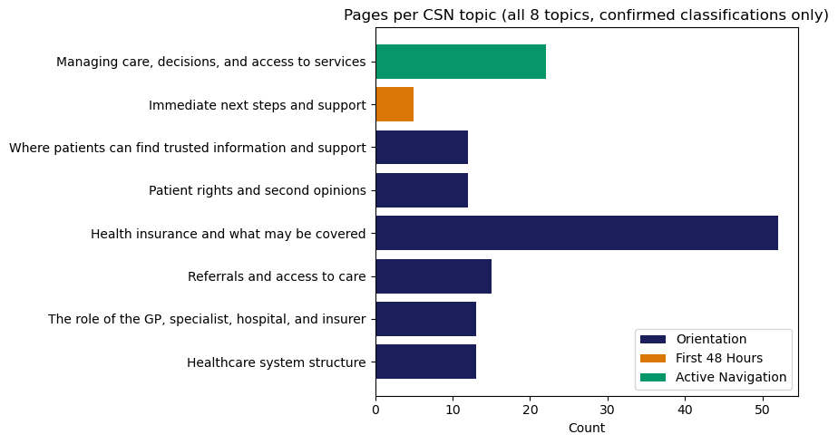
Initial Findings: Contribution by source + coverage by topic
42
kanker.nl
38
thuisarts.nl
31
zorginstituutnederland.nl
25
rijksoverheid.nl
8
nfk.nl
Pages contributed
Pages per Topic
Topic coverage highly uneven:
Health insurance and what may be covered
52 of 144 pages = 1/3 of dataset
Active Navigation content
22 of 144 pages
First 48hrs content
5 of 144 pages
⚠️ Not a flaw in our process = Reflects where Dutch sources concentrate their content !
7
8
Notes:
Tells CSN precisely where the current information base is strongest, and where new source material would add the most value.
Add graph for what are the main sources covering the top topics - source to topic mapping graph!

Slide 32
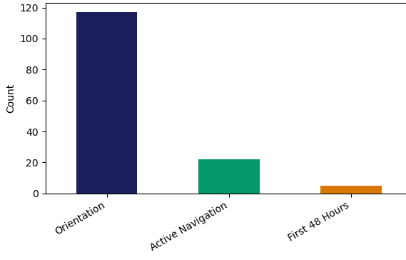
Initial Findings: Stage coverage and priority distribution
Priority Flag Distribution
Pages per Patient Journey Stage
117
Both derived from topic scope group
(Via Topic to Stage/Priority mapping)
81% High priority (1)
= Orientation
17% Medium priority (2)
= Active Navigation
17 % Active Navigation
22
5
3.5% - Low priority (3)
= Active Navigation
⚠️ Gap: First 48 Hours content is slim across the trusted sources
Recommendation: Expand into peer-support and community-authored content (e.g. CSN's own material) to provide information that would meaningfully support this stage.
9
Notes:
Explain how these both come off topic

Slide 33
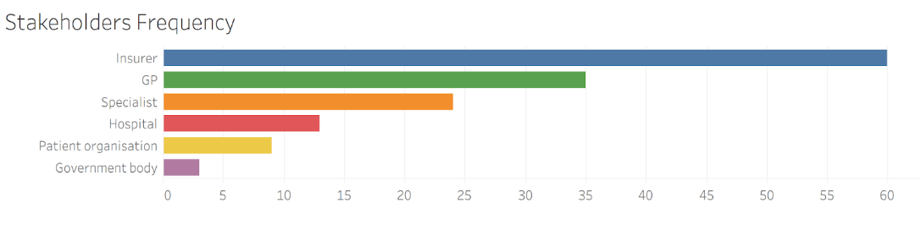
Initial Findings: Stakeholder coverage
Insurers are referenced in 60 of 144 pages
= more than any other stakeholder.
Coverage skews toward Procedural stakeholders (“who to deal with”: Insurer, GP, Specialist)
OVER
Advocacy stakeholders (“who advocates/governs”: Patient organisations, Government bodies)
GP (35) and specialist (24)
Reflects Dutch referral gatekeeper model
Patient Org. (9) & Gov. body (3)
are notably thin
Stakeholder Frequency
Page count
10
Notes:
Insurer dominates (60), more than GP and Specialist combined. That tracks with Orientation being about system structure and coverage — patients need to understand what's covered before they need to understand who treats them.GP (35) and Specialist (24) reflect the Dutch referral-gatekeeper model — the GP as first point of contact, the specialist as where referrals lead. Together with Insurer, these three "process" stakeholders account for the large majority of mentions, which matches Orientation's brief of explaining roles in the system.Patient organisation (9) and Government body (3) are notably thin — and this is the more interesting finding for the slide. NFK (a patient advocacy organisation) and Rijksoverheid (a government body) are two of your five approved sources, yet the stakeholders they represent barely appear in the content. That's worth calling out explicitly: the source publishing the page isn't the same as the stakeholder the page is actually about — Rijksoverheid publishes information that's mostly about insurers and GPs, not about government bodies acting as a stakeholder in the patient's journey.
"Looking at stakeholder coverage in the Orientation dataset, Insurer is by far the most frequently referenced stakeholder, followed by GP and Specialist. That makes sense given Orientation is about helping patients understand how the system works before they start treatment — patients need to understand coverage and the referral pathway from GP to specialist before anything else.
What's more interesting is the other end of the chart. Patient organisation and Government body are barely represented, despite two of our five approved sources — NFK and Rijksoverheid — specifically being a patient advocacy organisation and a government body. That tells us these sources are publishing content that's mostly about insurers and GPs rather than content where the patient organisation or government itself is the stakeholder the patient needs to interact with. It suggests that patient-rights and advocacy-specific content — things like how to raise a complaint or get support from a patient organisation — may be thinner in the current dataset than the source list alone would suggest."

Slide 34
Initial Findings: Best sources + Question coverage
All 144 pages mapped against CSN’s 17 community questions + 5 additional Qs added under the original
16
Kanker.nl
11
Thuisarts.nl
7
Rijksoverheid.nl
5
NFK.nl
4
Zorginstituut.nl
Answers the most Qs
Answers the least Qs
Community question: | Pages : | Status:
What does my health insurance actually cover, and what will it cost me? | 39 | Well-covered
What additional services can I access? | 26 | Well-covered
How are treatment decisions made? | 14 | Well-covered
What should I expect when I visit my GP, and how does registering work? | 12 | Well-covered
How do I get referred to psych care, physiotherapy, nutrition advice or fertility support? | 6 | Covered
How do I make a complaint about my care or a healthcare provider? | 5 | Covered
How do I find reliable health information or a trustworthy provider? | 5 | Covered
11
Notes:
Kanker.nl and Thuisarts.nl together account for the majority of question coverage, and just 4 of the 20 community questions make up roughly 63% of all classified pages (91 of 144) — insurance/cost, additional services, treatment decisions, and GP process dominate the dataset.
These four questions are the strongest foundation for a first-release Patient Navigator — high page volume means CSN can be confident these answers are well-substantiated and ready to publish.
Again mention in tableau will be able to filter this by which source covers the most topics, the most questions, the most patient stages

Slide 35
Initial Findings: Overlaps & Gaps
Gaps
Overlaps
8 Pages with topic but NO question
13 Questions are answered by multiple source organisations
6 Question with only ONE source page
EG. How are treatment decisions made:
kanker.nl // nfk.nl // rijksoverheid.nl // thuisarts.nl
- Is it normal to wait between steps?
- How long should I expect to wait for appointments or treatment?
- Am I allowed to get a second opinion, including in another country?
- How do I request a second opinion?
- Can I request explanations in simpler language?
- What if I don't understand medical terminology?
13 Questions are answered by multiple pages (previous slide)
Why?
- What can I do if I feel the process is too slow?
- Will a second opinion be covered by insurance?
- Are there English-speaking healthcare providers?
Gaps: Some question gaps due to near-duplicate questions
= content exists but was tagged to a closer-matching sibling instead.
3 Question with NO source page
Overlaps: Multi-source coverage is genuine, not duplicated — each source contributes a distinct angle, not repeated content.
12
Notes:
"A few of these zero-coverage questions aren't true content gaps — they're classification artefacts. Several question headers group very similar, closely-worded questions together — for example under Waiting Times, 'What can I do if I feel the process is too slow?' sits right next to 'Is it normal to wait between steps?'. When a source page's content answers that general theme, it gets tagged to whichever specific question it most closely matches — so the answer exists, but only one of the two similar questions ends up with a source, and the near-duplicate reads as a gap. That said, not all three are like this — 'Are there English-speaking healthcare providers?' and 'Will a second opinion be covered by insurance?' appear to be genuine content gaps, not classification overlap, so those are worth flagging to CSN as areas the approved sources simply don't address.”
"While 13 questions are answered by multiple pages, this isn't redundant duplication — each source page contributes a different angle on the same question. No two summary or answer texts for the same question are worded the same way, which suggests genuine complementary coverage: for example, one source might explain the legal right to a second opinion while another explains the practical steps to request one. That's actually a strength for the Patient Navigator — it means CSN can cross-reference multiple perspectives on the same question rather than relying on a single source's framing."

Slide 36
Recommendations
Leverage the dataset structure to build a Navigator that does more than answer questions
- helping patients navigate with confidence, while targeting new sourcing at the gaps identified.
Five specific properties of our dataset make this possible:
Priority reflects patient journey stage:
Content can be sequenced automatically — Orientation material shown first to a newly diagnosed patient.
Stakeholder tagged separately from topic:
Guidance can be filtered by who's involved — insurer, GP, hospital — not just by subject.
Action type tagged separately from content:
The Navigator can distinguish a step to take, a decision to weigh, or background to know.
Every row retains URL and scrape date:
Can always link back to the real Dutch source, not just present an answer.
Our Evidence-gap tracking:
The Navigator can say “we don’t have a confirmed answer yet” instead of guessing.
13

